Slide 1
SDDC Hyper Converged and Hyper Scale infrastructure Impacts on DC concepts operations today and in the future

Slide 2
Agenda
SDDC introduction
Datacenter Infrastructures
Hyperconvergence (HCI)
SDDC Impacts and benefits
Notes:
The Agenda today.
We will stare with a short introduction of SDDC, followed by an overview of the different type of Datacenter Infrastructure.
We will make focus on the Hyperconverged infrastructure and We will finish what is SDDC and these impact

Slide 3
1.
SDDC
Software Defined DataCenter

Slide 4
in an Software Defined DataCenter
all infrastructure elements such as servers, storage, networking devices are virtualized and delivered as a service
Notes:
A short definition of what is it
…..
In other words, the software is abstracted away from the hardware, which allows organizations to manage their compute, storage and networking resources as virtual pools.
Instead of having to configure hardware manually, staff can control their infrastructure from one central software interface.
This type of architecture not only saves IT staff time, it also gives organizations more flexibility.
In addition, it makes it easier to use inexpensive, commodity hardware rather than integrated solutions
Datacenter are "static", inflexible, inefficient. SDDC tends to optimize, make agil and dynamic the datacenter part of the ITTo archive these goals everything should be virtualize as resources.
With SDDC Resources will be automatically provisionned with the less human footprint and managed with predifned policy that incorporate the business logic.
Doing this result on provisioning infrastructure to support new App in minute not Weeks making very happy business executives.

Slide 5
SDDC Requirement
Software Defined Storage
Software Defined Network
Compute Virtualization
Automation
Policy

Slide 6
2.
Datacenter Infrastructures
Notes:
So we have introduced what is a software defined datacenter. Now we quickly review the different type infrastructures

Slide 7
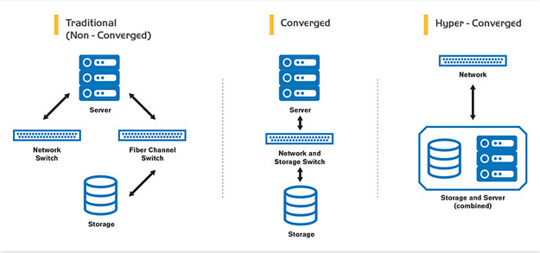
Different DC Infrastructures
Quick overview of the differences between traditional datacenter, Converged and Hyper-Converged

Slide 8
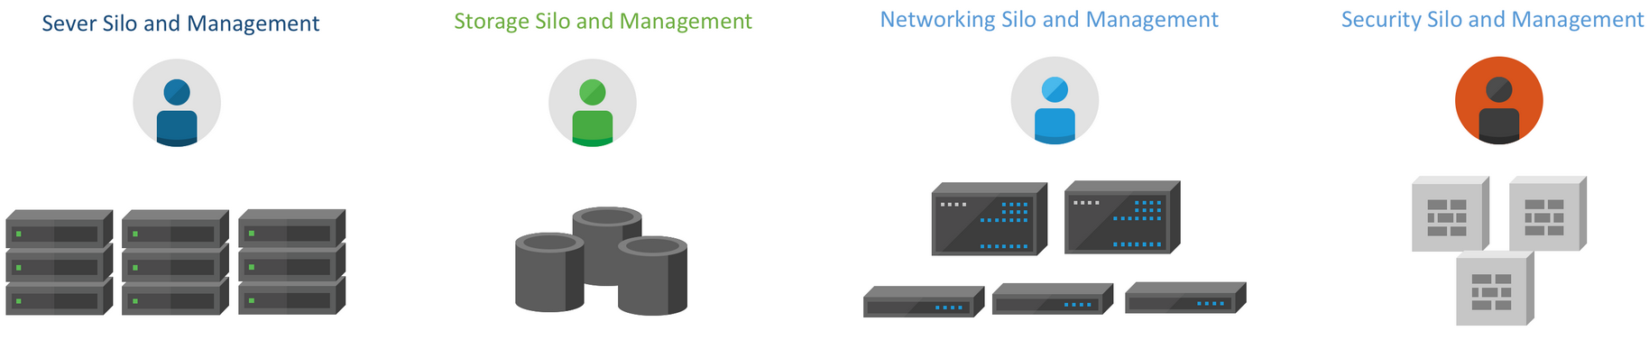
Traditional DataCenter
Silo organization
Dedicated specialist per domain
Time to provision can be very high when multiple team are imply
Multiple Management Interface
Waste of resources
Difficult to maintain
Poor flexibility
Poor automation due to the number of technology/vendor
Notes:
Let’s start with The traditional Datacenter. It‘s composed of different type of hardware and Vendors.
It’s most of the time organized in Silo, the Storage team, the network team, the unix team, the windows team, and so:
It needs to have dedicated specialist per domain because is not common to have people having all knowledge for all of type of IT components.
This imply the usage of multiple management interface and not facilitate the interaction between them.
We also see waste of resources, CPU used for storage silo could be under used while Servers CPU are overloaded.
Hard to maintain due to the number of actors/vendors/teams involved, automation also suffer from this diversity of technology
In another word, there are a lot of improvement to make and of course a lot of money to save.

Slide 9
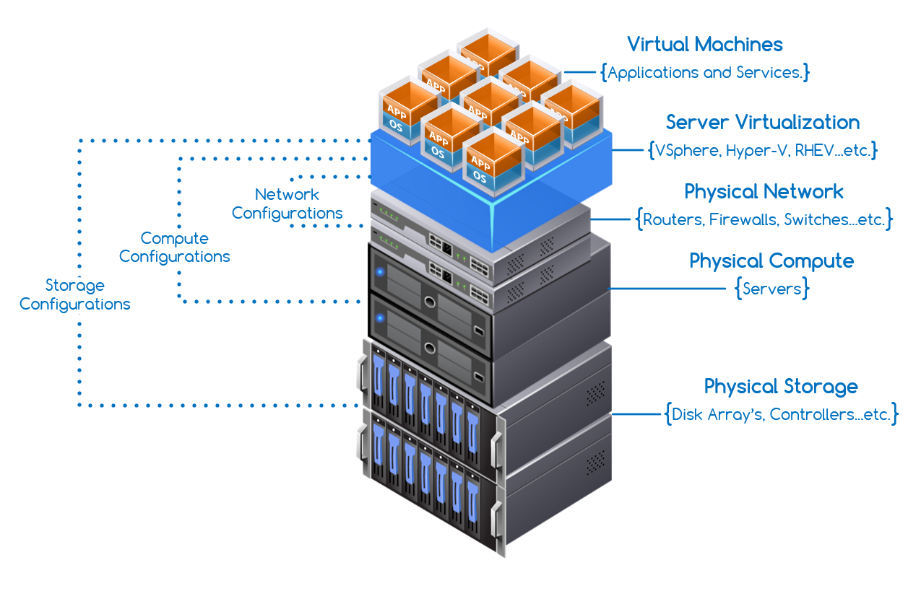
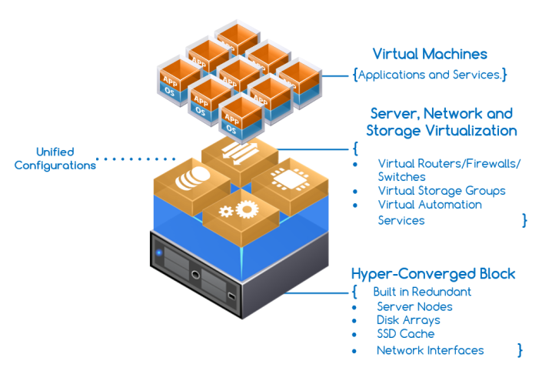
Converged
Converged & Hyperconverged
HyperConverged
Notes:
Converged
Often only one vendor with an integrated solution of different hardware, putting on the same rack network, storage. Dedicated and specialized hardware are packaged but still needs different knowledge and still remain the overall complexity of management system
More efficient than traditional Infrastructure but it still have some limitations;
- high cost due to the underline hardware (storage array still exist, etc) what need to be purchase upfront ;
- operations and maintenance are managed differently in function of the hardware,
- compatibility stack between them; - etc;
- Cost, As helpful as convergence was, it was largely inapplicable to the mid-market and below because converged infrastructure orders are placed on the order of racks and rows and the buy in starts at hundreds of thousands of dollars. A more granular approach was needed for the rest of the market.
As well, the combination of existing technologies eased the procurement and deployment burden, but did nothing to address the ongoing operation complexity that plagued many organizations (think about Normal Datacenter common weakness). To address that, an entirely new model was needed.
Hyperconvergence, as an evolution of convergence. It addressed those challenges by rethinking all the services and hardware that make up a modern infrastructure.
Hyperconvergence really builds a unique solution without disparate pieces.
Running everything in top of Hypervisor allow us to grow-up and scallout, it also permit the integration of Network and Storage.

Slide 10
3. Hyperconvergence
HCI, the easy path to SDDC
Notes:
What is hyperconvergence ?
We already said that is an evolution of Infrastructure convergence
Fundamentally, hyperconvergence is a way of constructing private data centers that seeks to emulate public cloud consumption in terms of its operational simplicity, economic model, and scaling granularity.
And it provides all of this, of course, without sacrificing the performance, reliability, and workload availability that businesses today rely on.

Slide 11

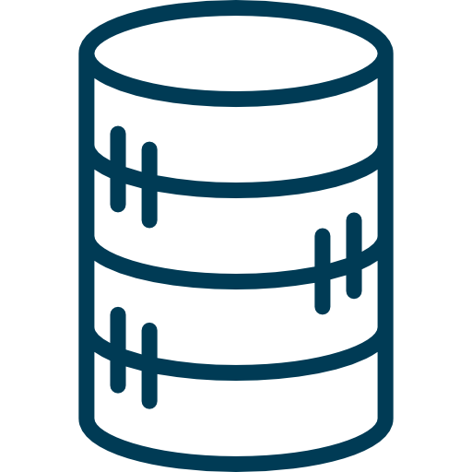
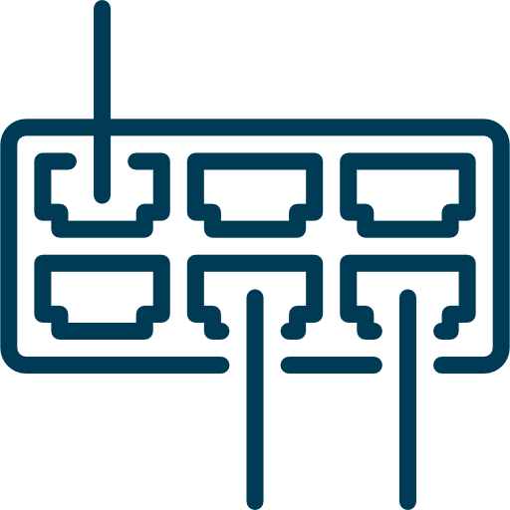
Hyperconverged Infrastructure Provide
Compute Virtualization
Software Defined Storage
Software Defined Network
Notes:
Compute Virtualization
Hypervisor and Virtual Machine are now the standard on all Datacenter. The Hypervisor is a key of HCI.
A performant Hypervisor integrated SDS and SDN reducing latency and increasing performance of the whole infrastructure.
When is not possible SDN and SDS are run on Virtual Machine but this use more resources and is less efficient.
Software Defined Network (SDN)
With the rise of the cloud and the grow of internet usage, specially with smart-phone, big actor of the market push and develop SDN and now this technology is mature, sure and heavily deployed in production.
We can do anything now with SDN, switching, routing, firewalling, load balancing VPN, QOS, etc. and everything is made programmatically
Software Defined Storage
Big change for existing storage infrastructure that was built for the past. Current storage array are great to protect data, manage it and store it but are all segregate, in silos, not talking each over. Some vendors try to mix services like NAS/block, object but they still suffer on :
- Each array has it own specialized functionality and operational procedures => need specialist, no standard
- Application/VM needs and storage service aren't aligned => not best performance
- Operational workflow, are stove-piped between storage, application and virtualization teams => time consuming
SDS address theses constraint by abstracting and pooling storage attached to the x86 servers part of the HCI and incorporating them as part of the virtualized environment.
SDS advantage are :
- it enable application-centrix storage service, as the storage is software driven, the application can interact with
- it enable policy-drive automation
- it enables dynamic storage services
- it supports conventional storage array (making actual investment not wasted)
to gain performance in this area the utilization of Flash (or SSD) is mandatory. Having less hop (this include all network hop and switch) between the CPU and the storage will also increase the overall performance.
More closely is the storage more performance you gain. Putting the Storage along the Compute reach this goal and this is the reason why HCI adopted early the Software Defined Storage
Another advantage of the HCI, that is based on x86 servers, and the performance of x86 CPU are still grow-up. Another advantage is x86 hardware including flash memory, are in general shipper than compared storage arrays.

Slide 12
HCI help IT
Consolidate
Server compute
Storage
Network switch
Benefits
Cost effective : pay as you grow
Scalability : easy to scale up and out
High performance
Increase efficiency
Improve agility
Ease
Data protection
Global management
Installation and deployment
Notes:
Cost effective :
Start with few nodes and grow as you need, not necessary to pay for a big Storage array at day one.
The result is a system that is a whole new kind of simple, which leads to operational efficiencies and a reduction in OPEX spending because the same number of personnel can accomplish more than they previously could thanks to the simplicity.
Adopters also see CAPEX savings in that the initial purchase can be as small as a couple of servers (as opposed to an entire rack packed full of gear). As the infrastructure expands and more resources are needed, businesses buy only what they currently need
Scalability :
it is resumed by racking another tiny x86 servers, and connect it to the rest of the HCI cluster
Data Protection :
Data are split across all nodes and a failure of one or more nodes didn't impact on the data availability (depend on the configuration).
Snapshot, data replication, etc there is a lot of software protection implemented now.
High performance :
Whit SSD, flash module and 10Ge link we reach the same performance than fiber channel and bigger Storage Array
Efficiency :
Less time spent between teams to provide resource or applications for the company or other IT services (developer)
Agility :
Does everything from one interface and often one team improve agility and response time to over services of the company

Slide 13
SDDC Requirement
Software Defined Storage
Software Defined Network
Compute Virtualization
Automation
Policy
Hyper
Converged Infrastructure
Notes:
As we see before HCI provide at least 3 of 5 requirement to implement a SDDC.
Automation can be done by HCI or by a tier application but it will use and benefit of the single interface, or API, of the HCI plateform
The Conclusion is that Implementing an HCI is the easy way to obtain a SDDC.
It’s More painful is if you try to implement it from traditional or converged Infrastructure, just think about the traditional datacenter and the effort to make all these components working together, it will become quickly a nightmare.
Once HCI is in place, Adding automation for provisioning and implementing policy (for placement, creation of resources) will allow us to create our full SDDC.

Slide 14
4.
SDDC Benefits
Not only for IT

Slide 15
SDDC Benefits using HCI
Time Savings
Centralized Interface, no longer have to walk around and physically touch the actual hardware in order to accomplish most of their d2d task
Simplify operations
Centralized management, Automation and deep integration of all resources simplify the d2d activity
Cost Savings
Analytics and Insights
Run on commodity hardware.
Resources are pooled together and consolidated.
Pay as you grow
Reducing operational time reduce the TCO.
Energy efficient system
Monitoring of all integrated components opens up the possibility of using modern analytics tools to help to optimize the system for more efficient and cost-effective operation
Better Scalability
Flexibility
Quick response to the market and business change.
Provisioning task are perform on minutes instead of days or weeks
Just add more simple and ship x86 Server to increase the total power and capacity of your datacenter
No more need to shutdown your infrastructure to migrate to newer system.
Highly performance using SDD/HDD and Flash
Notes:
To resume all benefits using HCI for an SDDC implementation are :
Time Savings
Because SDDC managers can configure, monitor and maintain their systems from a centralized interface, they no longer have to walk around and physically touch the actual hardware in order to accomplish most of their day-to-day tasks. Automation handles many jobs that would otherwise need to be done manually. As a result, managers spend much less time on these activities, freeing them up for other responsibilities. And time is money.
Cost Savings
SDDC architecture save money both in terms of capital expenditures and operational expenditures.
On the CAPEX side, SDDC can run on commodity hardware, which in general is less expensive than proprietary systems. In addition, resources like compute, storage and networking are pooled together.
In terms of OPEX, as already mentioned, the automation in an SDDC reduces the amount of time that staff spend maintaining the systems, which helps reduce total cost of ownership (TCO). In addition, because many organizations deploy hyperconverged infrastructure in their SDDCs, they also frequently save on real estate and energy costs as well.
Flexibility and Agility
Markets are constantly changing, and businesses shift in response in order to take advantage of new opportunities. Often this requires corresponding changes in IT infrastructure, and SDDC architecture allows organizations to make these alterations much more quickly than would traditionally be the case. Instead of needing weeks or months to provision servers and storage for a new application, IT with an SDDC can often perform the task in just minutes.
Simplify operation
Advanced Monitoring, Single-Pane-of-Glass Management, Taking Operations Down to the Virtual Machine Level, Automation Driven by Policies
Analytics and Insights
In an SDDC, monitoring tools are constantly collecting log data about the performance of various systems. That opens up the possibility of using modern analytics tools to comb through the data for insights that can help optimize the systems for more efficient and cost-effective operation.
Scalabiility & Reliability
Because resources are pooled and workloads can be shifted as necessary, an SDDC is also more resilient than a traditional data center. If a particular piece of hardware fails, the management software can simply move the workload to a functioning piece of infrastructure — often without the need for manual intervention. In addition, the most advanced SDDC management software may include analytics capabilities that can alert staff in advance when problems are likely to occur so that they can take action proactively.
Scalability is improved, it just consist to add more x86 servers. You can start with low and grow as you need

Slide 16
THANKS!
Any questions?

Slide 17
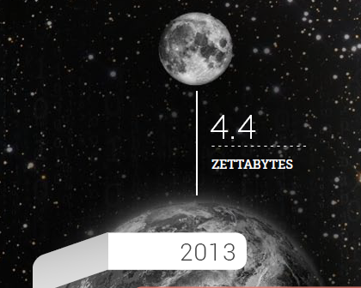
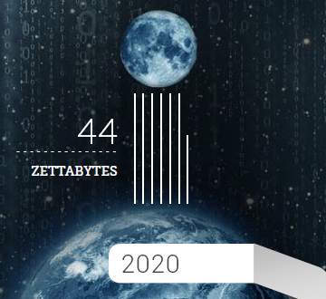
Data Doubles every two years
From 2013 to 2020, the digital universe will grow by a factor of 10, from 4,4ZB to 44 ZB*
2/3 of Data Is Created by Consumers, but Enterprises Are Responsible for 85% of This
IT needs to adapt their infrastructure to address the storage challenge
*Source IDC 2014⬄ The digital Universe of Opportunities
Notes:
2/3 of DU Is Created by Consumers, but Enterprises Are Responsible for 85% of This
Why ?
New business models --
The IoT will help companies create new value streams for customers, speed time to market, and respond more rapidly to customer needs.
Real-time information on mission-critical systems –
Enterprises can capture more data about processes and products more quickly and radically improve market agility.

Slide 18

Good Bye !
I am François Conza
You can find me at francois.conza@free.fr

